Slide 1














Come with Ideas, Leave with Funded Startups

Slide 2
Basic Details of the team
Idea Title : Web_Raksha
Team name : Leo
Team leader : Neeli Salmann
Other Team Members : None
Track : Web 3.0
START-A-THON : IDEATION Come with Ideas, Leave with Funded Startups

Slide 3
Problem Statement Details
Fraud and Duplicate websites are the biggest problem.
Around 1.35 Million Phishing sites detected in the 4th Quarter of 2022.
Around 18000 fraudulent sites are created Daily.
The problem is big enough that government itself mentioned about fake websites in the main page of passportindia.gov.in
Every Internet user directly or indirectly affected by these fraud websites.
Especially Illiterates and people above 40 can’t find the difference between real and fake websites.
START-A-THON : IDEATION Come with Ideas, Leave with Funded Startups

Slide 4
Proposed Solution
START-A-THON : IDEATION Come with Ideas, Leave with Funded Startups
An App Web_Raksha is the one stop solution for all the problems.
Web_Raksha is a Browser which shows whether the website is Real/Duplicate/Phishing etc.
With the help of AI we will also provide overview of the website and the AI will analyse the comments and reviews of the website and suggest the actions accordingly.
For making it understandable for everyone Red,Yellow and Green Marks/Tags given for every website . where Red is Danger(Fraud),Yellow is Suspicious(but not yet confirmed) and Green is for safe(Government ,well known and safe websites).
As we go ahead many more features will be added to make it top notch.

Slide 5
Market Opportunity and Competitive landscape
There are 5.07 Billion Internet users in which every year nealy 2.4 million users get scammed .
The People of age group Below 17 and above 40(1.25Billion people) does not have much knowledge about safe browsing.
It’s a Billion dollar market.
Google,Edge and many browsers provide safe browsing.
These are my competitors but I will outperform them because
My key Moto and my complete promotion is based on Safe Browsing.
For example laptops come with Microsoft Defender but 90% of users use separate antivirus softwares.
START-A-THON : IDEATION Come with Ideas, Leave with Funded Startups

Slide 6
Business Model , Go-to Market Strategy and Funding Ask
There will Monthly , Yearly subscription plans which is my Major revenue stream.
Monetization is also an Revenue stream.
Based on the number of consumers we obtain in future the Revenue plans can be modified .
With the help of Social Media i am going to reach my targeted consumers and the person they depend on (like parents of children or caretakers of elders).
Taking it to next level in future by adding many features like :
AI which reviews and give you info and suggestions about the services or the products which are provided by a particular website.
“The internet is our future I am here to make it as safe as possible”
START-A-THON : IDEATION Come with Ideas, Leave with Funded Startups

Slide 7
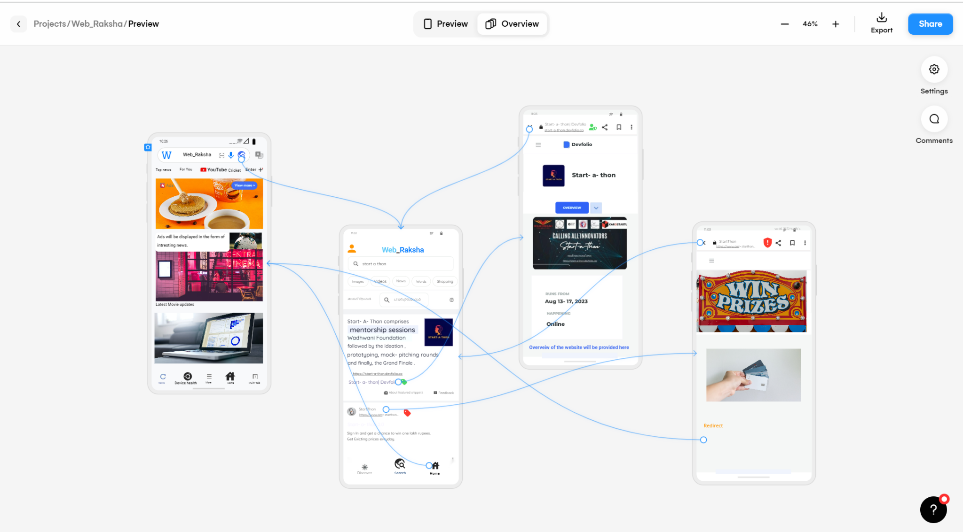
Web_Raksha Prototype

Slide 8
Youtube Link : https://youtu.be/qcdkbi7pMCM
For Video presentation of Idea and App prototype
App Prototype : https://app.uizard.io/p/ccd56644
From Uizard

